Slide 1

Banking Management System (MYBank)
Team Pentagon

Slide 2
Team Members and Roles :
Team Representative : Yash Rawat
Team Manager : Sahil Rana
Software Developer : Yash Rawat, Vishal Verma
Software Tester : Syed Nurja, Sahil Rana,
Yogeshwari Sonavane

Slide 3
Agenda :
Project Aim
Modules Description
Project Work Flow
Future Recommendations
Learning Outcomes
References
Functional and performance Specifications
Design
Detailed DFDs
Data structure, Database and File Specifications.
Project Legacy

Slide 4
AIM :
To provide better and faster service to the customers by digital transactions.
All the transactions between customer and bank are stored in a database that is the center of all information.

Slide 5
USER
LOGIN
REGISTRATION
DASHBOARD
CHECK BALANCE
TRANSFER MONEY
WALLET
OFFERS
ACCOUNT NUMBER
BILLS & RECHARGES
LOAN
SUPPORT
ER Diagram

Slide 6
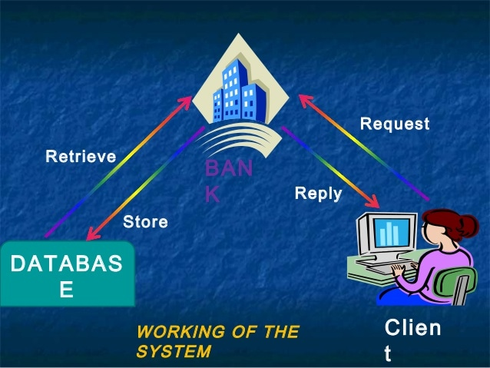

Slide 7
TECHNOLOGIES USED :
JAVA
JDBC
Oracle 11g
Launch4J
:

Slide 8
MODULE DESCRIPTION :
MODULE | DESCRIPTION
REGISTRATION | We create a new user by accepting user’s data like first name, last name, username, password, mobile number, Email, address, pan card number, Aadhar card number, account, gender, occupation.
LOGIN | We login a existing user on the dashboard by accepting user’s data like username and password .

Slide 9
CHECK BALANCE | We can check our account balance by accepting user’s data like username .
ACCOUNT NUMBER | We can check our account number .
TRANSFER MONEY | We can transfer money by accepting user’s data like amount, receiver’s name, receiver’s account number .
BILLS AND RECHARGES | We can pay bills and recharges i.e. mobile, gas bill, water bill, electricity bill by accepting user’s data like bill number, amount for bills and mobile number for recharge .
WALLET | We can add money to wallet by accepting user’s data like amount after getting the answer of the given question. Do you want to add money?(y/n)

Slide 10
LOAN | We can get loans i.e. education loan, car loan, home loan, gold loan by accepting user’s data like Aadhar card number and pan card number .
OFFERS | We can get offers i.e. loan offers, bills and recharges offers by accepting user’s data like loan amount , transfer amount .
SUPPORT | We can get support i.e. e-mail support, call support by accepting user’s data like first name, last name, email .

Slide 11
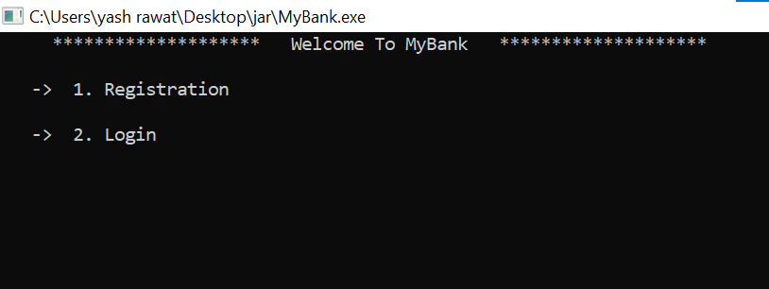
HOME SCREEN

Slide 12
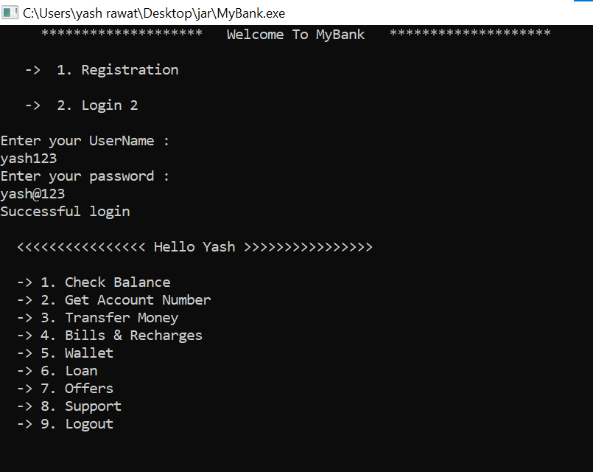

Slide 13
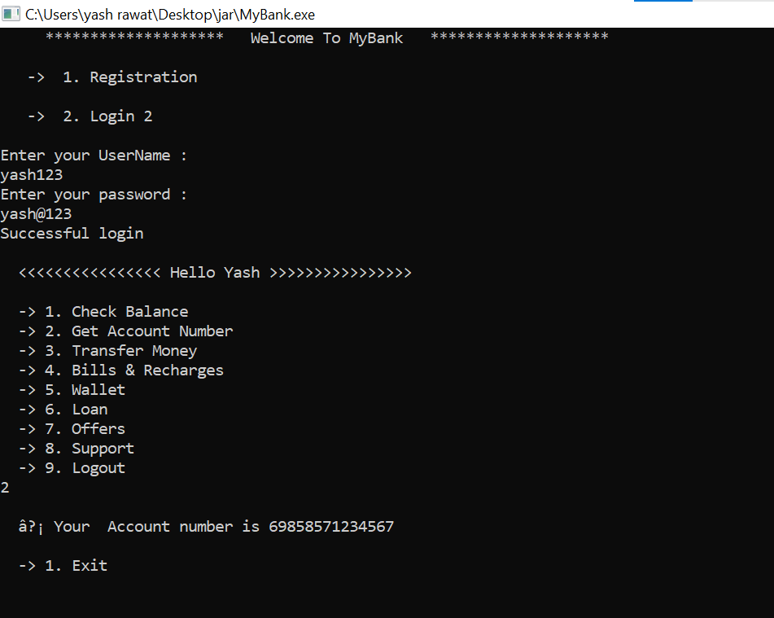

Slide 14
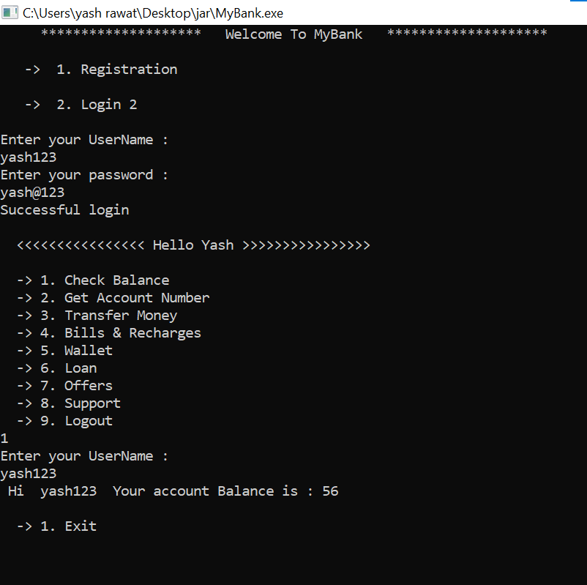

Slide 15
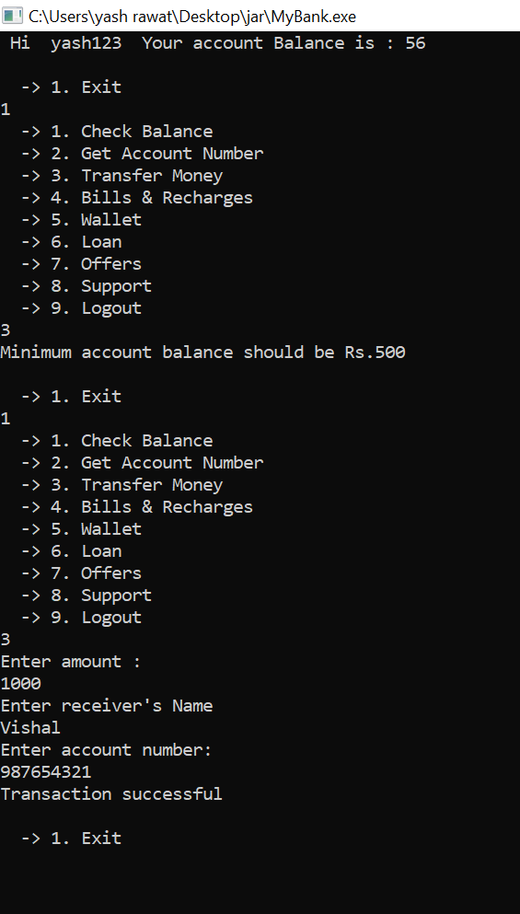

Slide 16
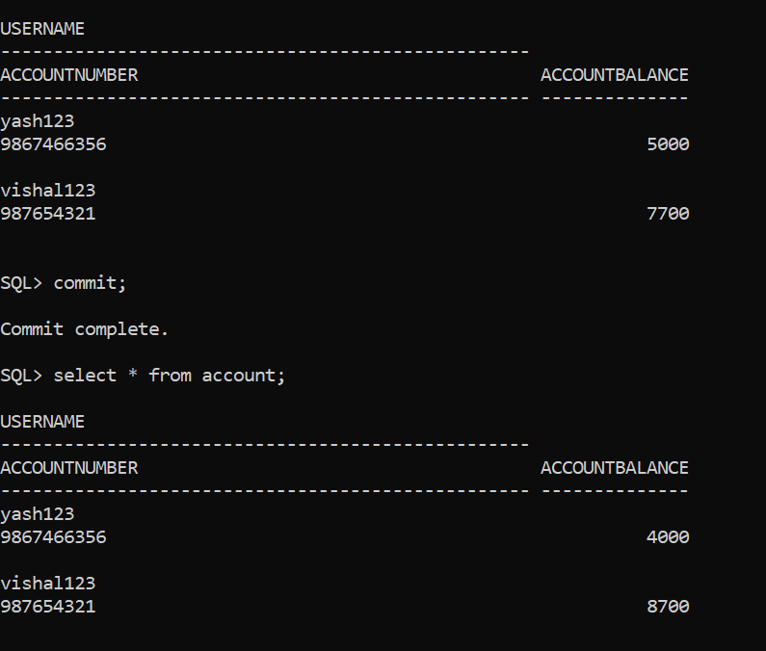

Slide 17
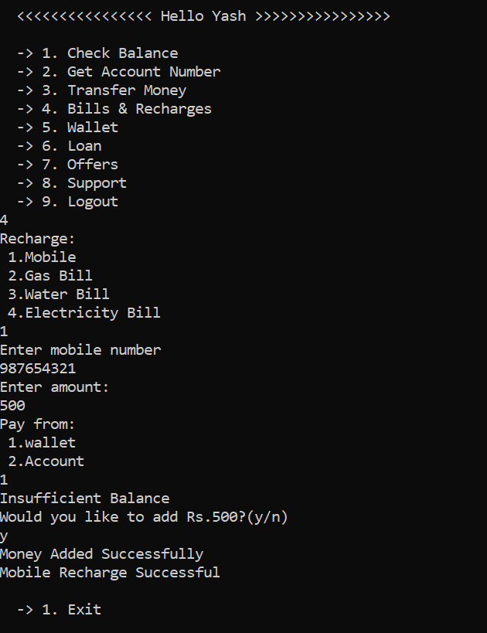

Slide 18
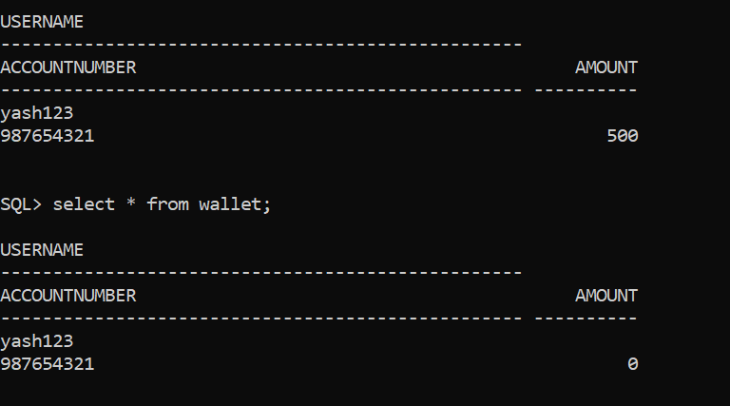

Slide 19
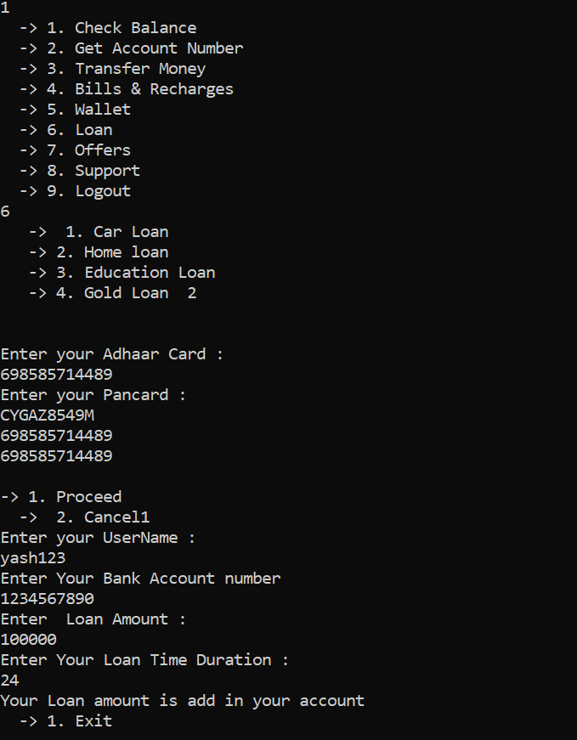

Slide 20
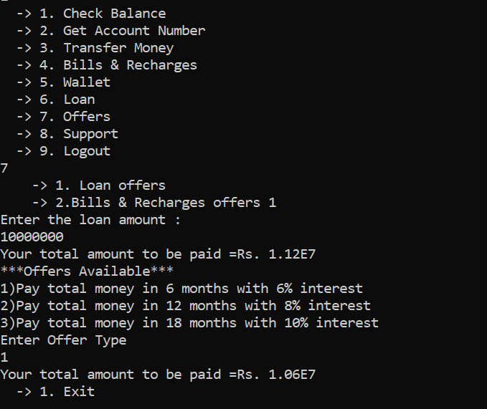

Slide 21
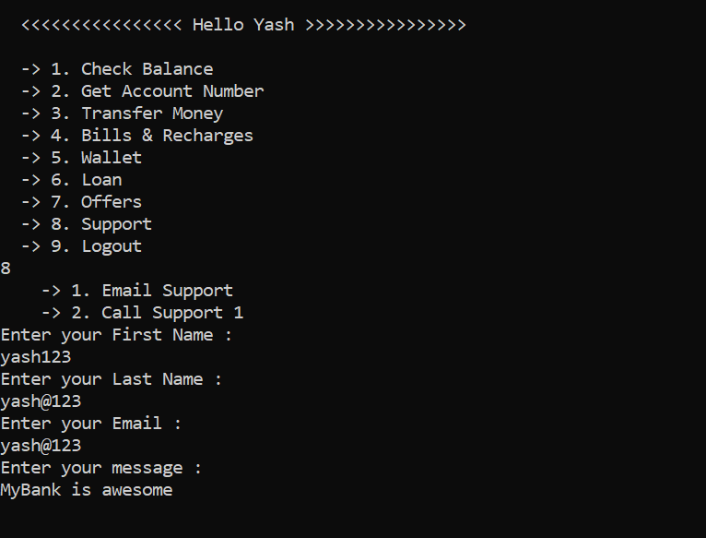

Slide 22
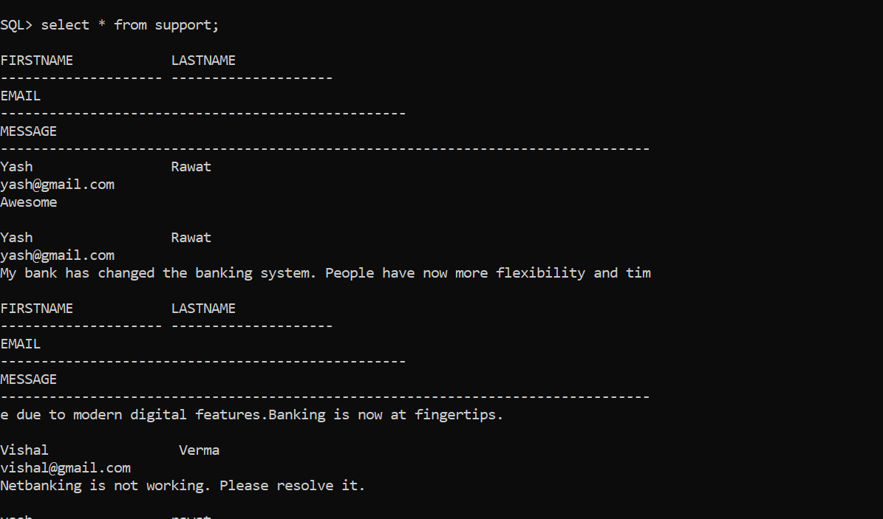

Slide 23
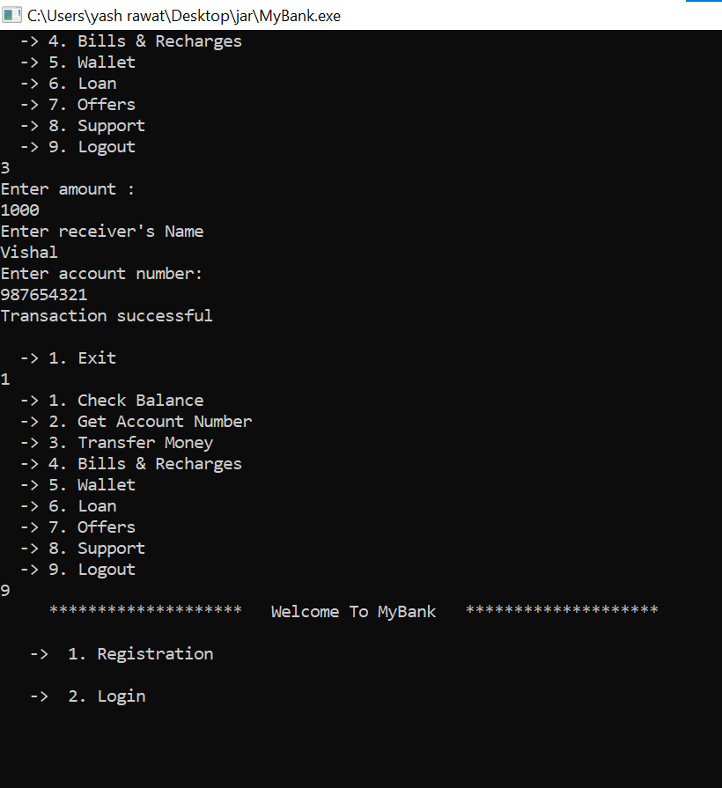

Slide 24
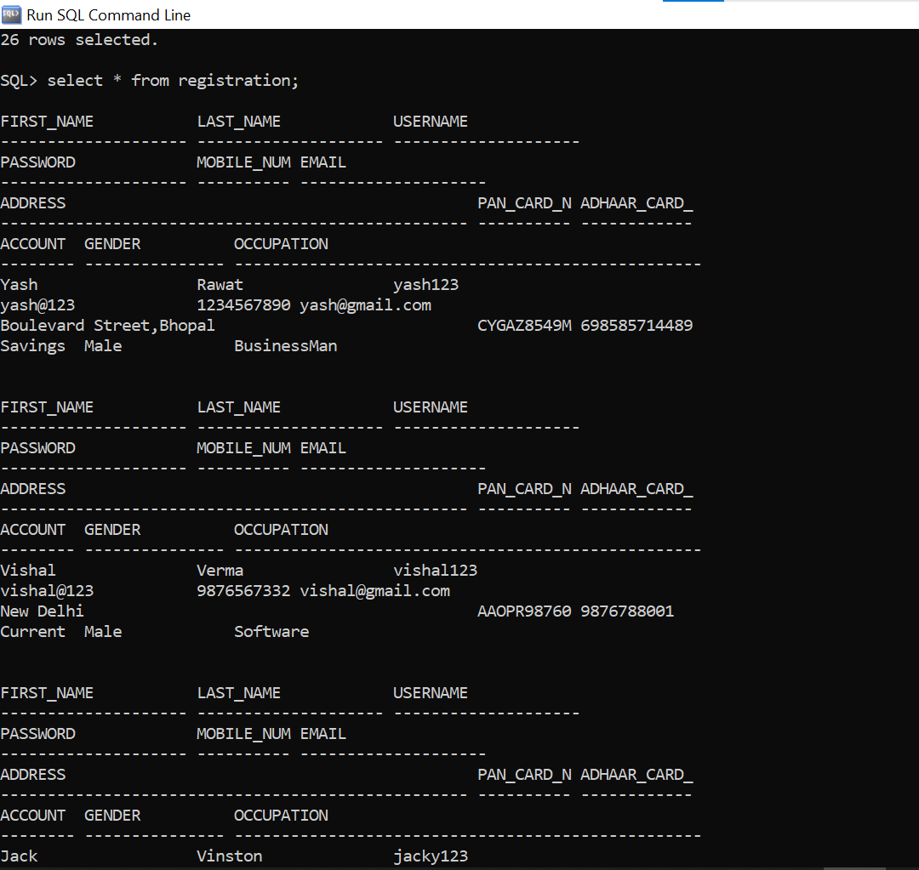

Slide 25
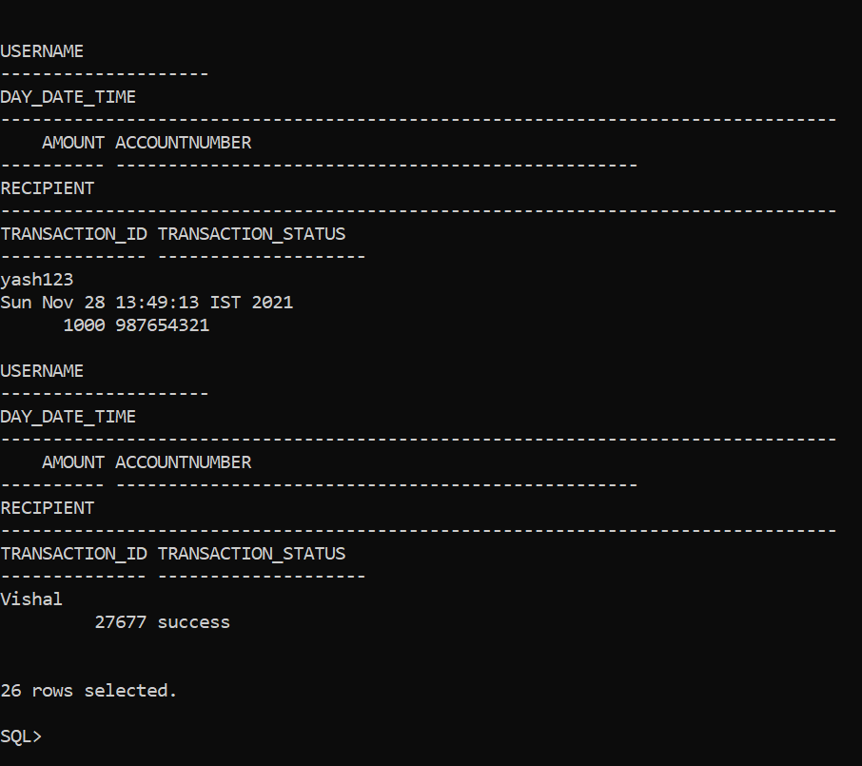

Slide 26
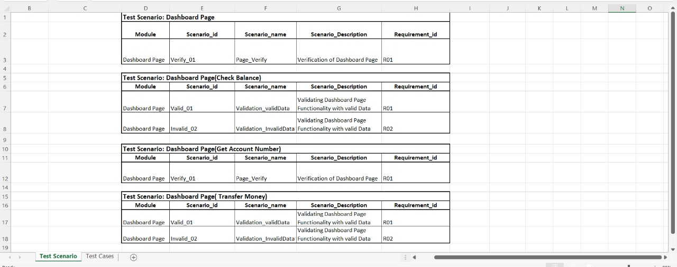

Slide 27
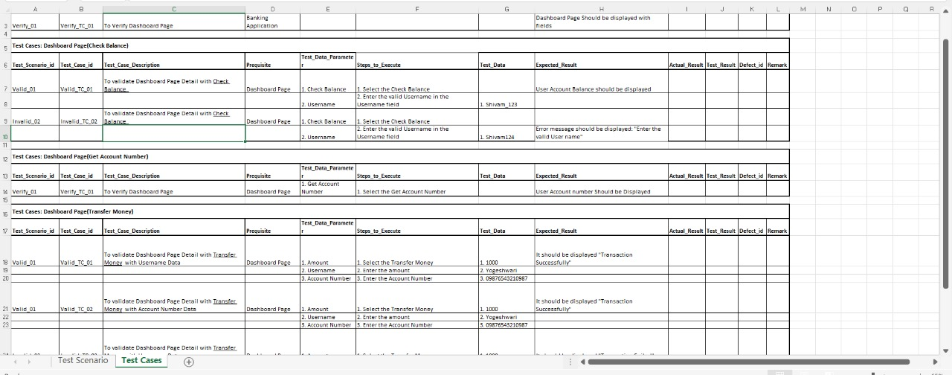

Slide 28
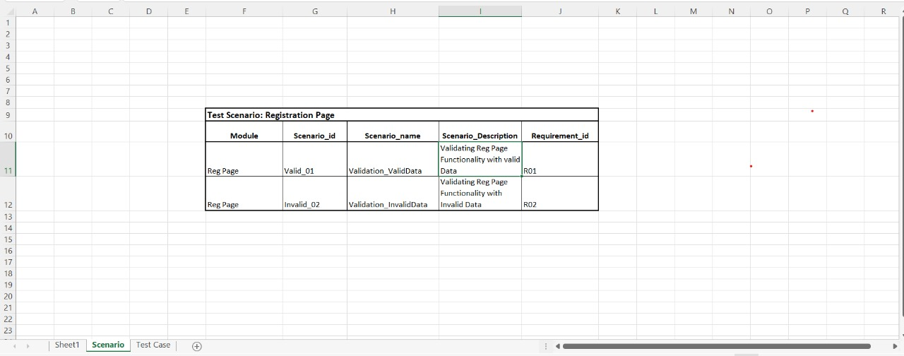

Slide 29
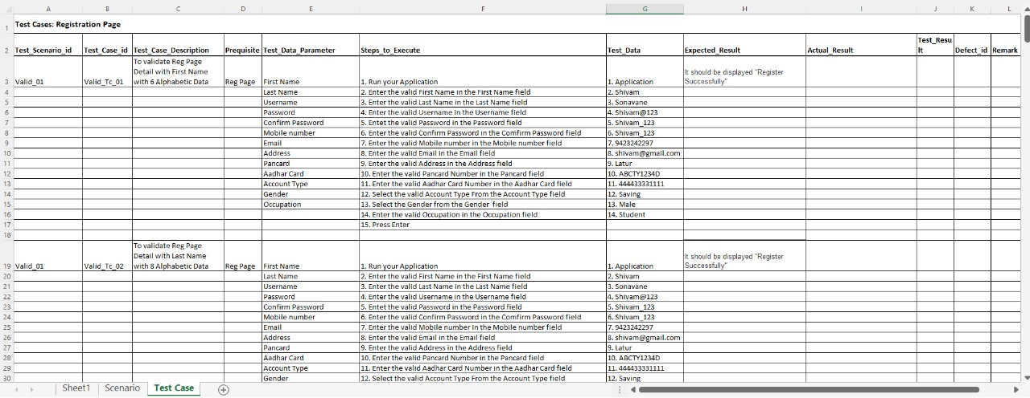

Slide 30
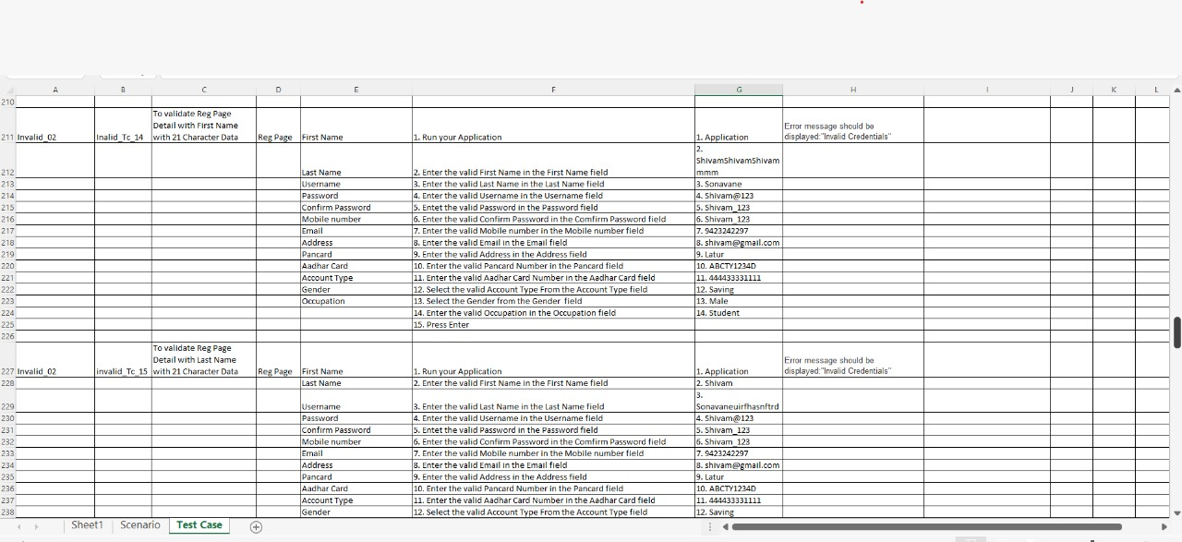

Slide 31
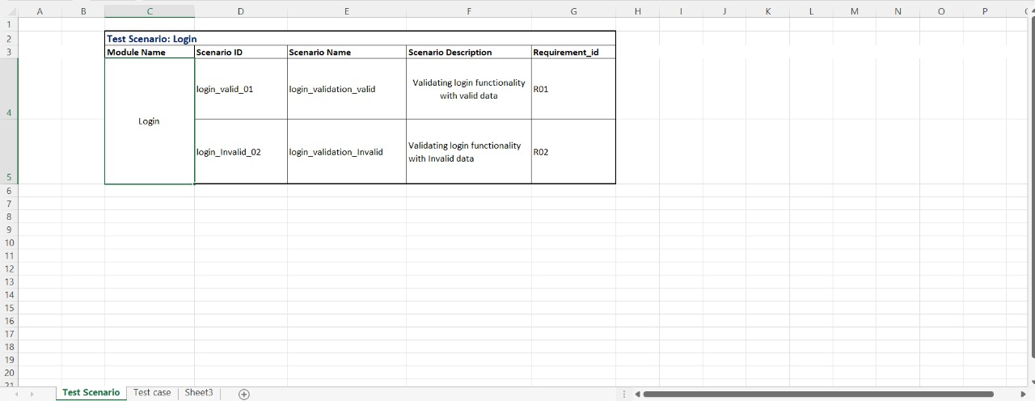

Slide 32
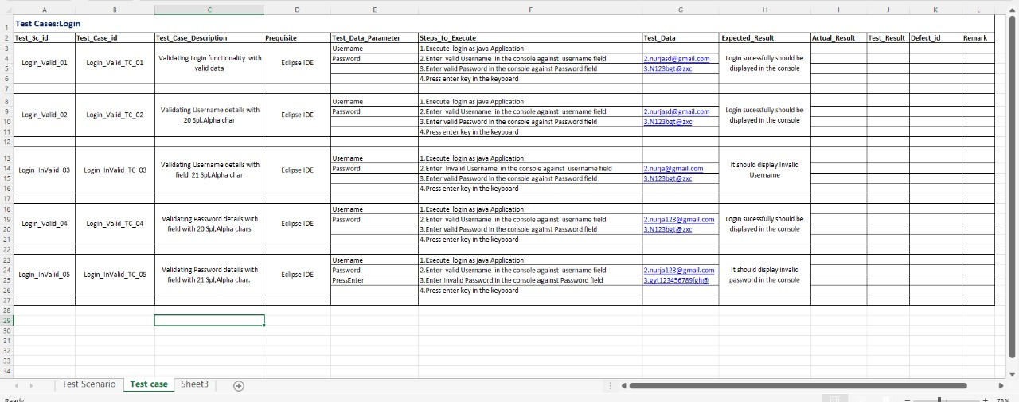

Slide 33
HARDWARE AND SOFTWARE REQUIREMENTS :
Hardware Requirements: Software Requirements:
Processor: Intel Pentium based system FRONT END: JAVA Console
Processor speed: 250 MHz to 833MHz Technologies: CORE JAVA
RAM : 1GB DATABASE: SQL(Oracle 11g)
Connectivity : JDBC
Operating System: Windows XP/7/8/10

Slide 34
FUNCTIONAL REQUIREMENTS :
Customer must have a valid user ID and password to login to the system.
The system shows the present balance in that particular account number.
Customers can relate details of the last transactions performed on any account .
Customers can make funds transfer to another account in the same bank .
Customers can also apply for loans i.e. education loan , car loan , gold loan , home loan .
Customers can also use the wallet functionality .
. Proper help to be provided as and when requested by the customer.

Slide 35
NON-FUNCTIONAL
REQUIREMENTS :
Secure access of required data
24x7 availability
User friendly
Intelligent user interface

Slide 36
FUTURE RECOMMENDATIONS :
This project can be handled in future by doing various modifications like: -
We can go further for Online Banking.
We can establish and start various Branches and available help centers for Account Holder’s Queries.
We can also deal through internet by creating web pages and a banking website for internet dealing.
To attract Account Holder’s we can offer various offers during festivals months.
We can also deal in various types of Banking Transactions.

Slide 37
Learning Outcomes :
OOPs concepts implementation using Java
Connectivity with Oracle database using Jdbc
SQL fundamentals
Manual Testing fundamentals

Slide 38
REFERENCES:
www.guru99.com
www.tutorialspoint.com
www.javatpoint.com
www.docs.oracle.com

Slide 39
THANK YOU
TEAM PENTAGON

